Slide 1


Agile Retrospectives
Notes:
Welcome to this training on retrospectives.
The timeframe for this training is approximately 2 hours after which there will be time for Q&A.
The contents of this presentation are licensed under a Creative Commons Attribution-ShareAlike 4.0 International License.
For more information about the license, visit:
http://creativecommons.org/licenses/by-sa/4.0/

Slide 2
Today’s Schedule
What?
How?
Why?
Notes:
Today we will look at the following topics:
Why do we do retrospectives.
How to do a retrospective, were we will go through the theory of retrospectives, how they are structured and will look at some examples of each phase in a retrospective.
What do we do in retrospectives. Last but not least we will go through several tips & tricks from real life retrospectives and an overview of resources to learn more about retrospectives.

Slide 3

Notes:
But first we will play a game!
[Notes for presenter]
Play a ball game:
3 balls are used in this game.
Make sure a roll of duct-tape is available.
1 person needs to keep time.
1 person needs to record the results on a flip chart.
A group of 6 to 8 people need to pass/throw the balls around. After this first round the group needs to iterate and evaluate to do it faster each iteration with the following requirements:
The order in which the 3 balls are passed needs to stay the same.
Each person needs to make contact with all the balls one by one.
Anything else is allowed.
At the end of each iteration the group evaluates and discusses improvements.

Slide 4

Notes:
Observe and discuss the results of the ball game with the entire group of training participants.

Slide 5
WHY?
Notes:
To learn how we can do retrospectives, first we need to understand why we do them.

Slide 6
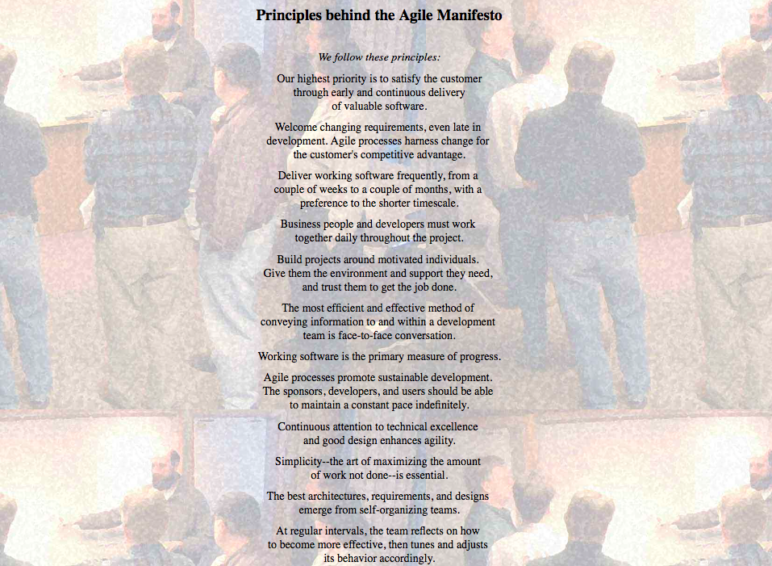
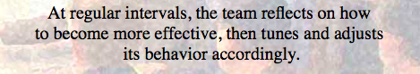
Notes:
Ask the following questions to the group:
Who is aware of the Agile Manifesto and it’s contents?
Who is aware of the 12 principles behind the agile manifesto?
One of the 12 principles behind the agile manifesto is: “At regular intervals, the team reflects on how to become more effective, then tunes and adjusts its behavior accordingly.”
But let’s go further back in time a bit and see where this originated from.

Slide 7
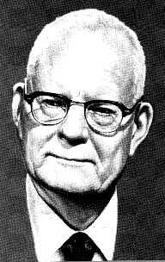
Why do we do retrospectives?
W. Edwards Deming
WHY?
Notes:
Who knows who this is?
Meet mr. Deming, besides many other management thoughts he is of course known for the plan-do-check-act cycle.

Slide 8
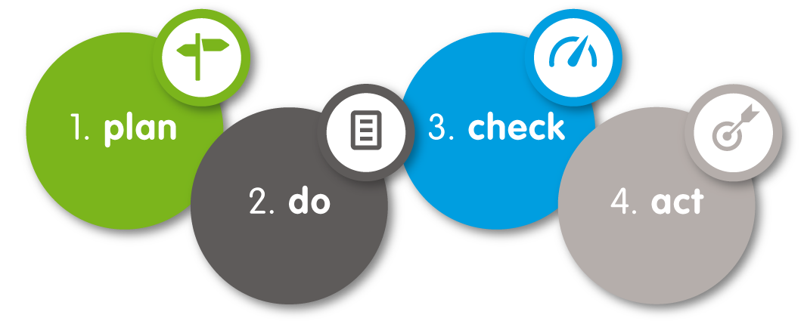
Why do we do retrospectives?
WHY?
Notes:
Now where do retrospectives fit into this cycle?

Slide 9
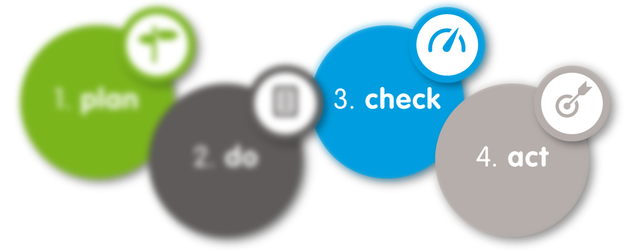
Why do we do retrospectives?
WHY?
Notes:
If we look at agile retrospectives, they reflect the check and act stages of this cycle. In a retrospective you reflect on a certain period and define actions to improve the next cycle.

Slide 10
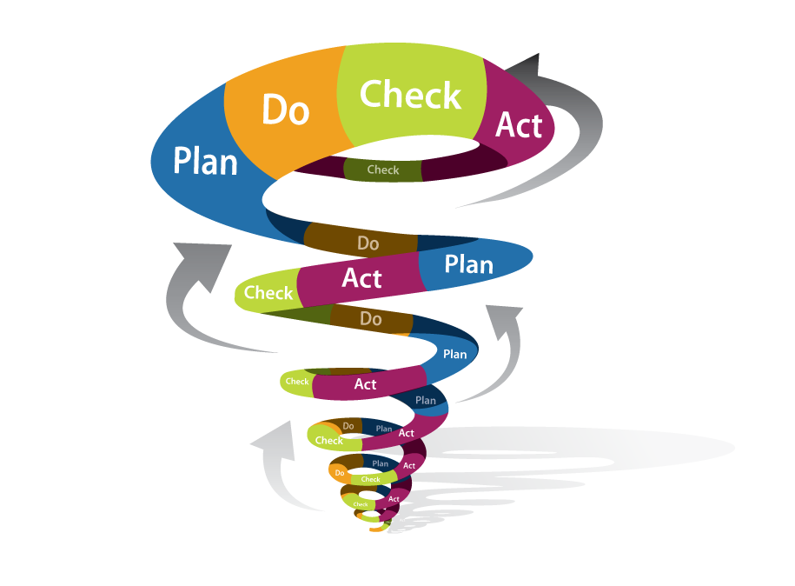

Why do we do retrospectives?
WHY?
Notes:
The plan-do-check-act cycle should be a continuous process that is never done, ending the loop gives you input for the plan of the next cycle and that will just keep on repeating.
Which results in……. Continuous improvement.

Slide 11
Why do we do retrospectives?
What if we don’t?
WHY?
Notes:
What happens if we don’t do any retrospectives? Do you even need them if you are already a good team?

Slide 12
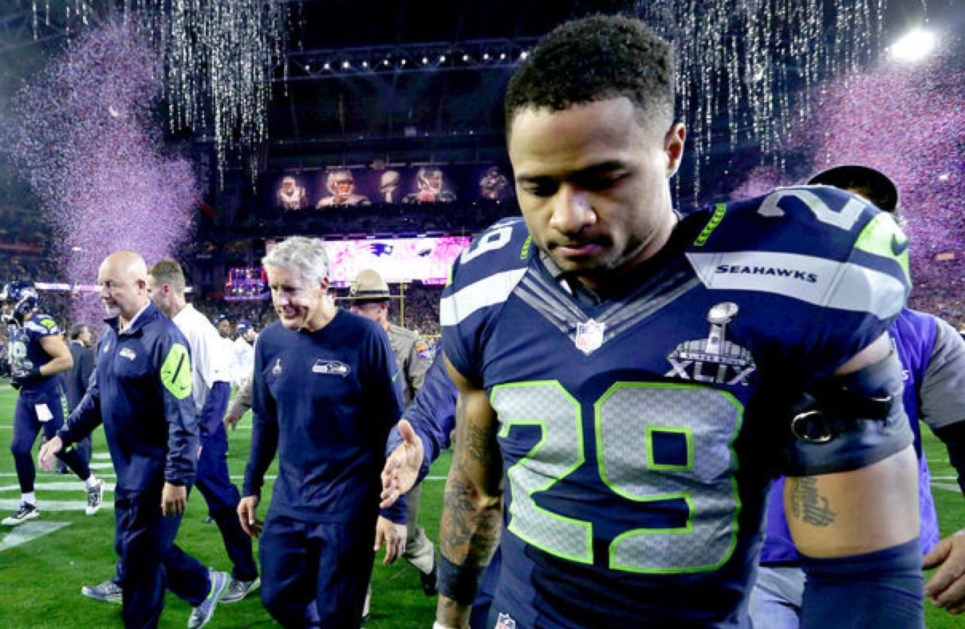
Notes:
The question is do you want to be a team that just does the work, continuously on the same level? With the risk of being beaten by the competition?

Slide 13
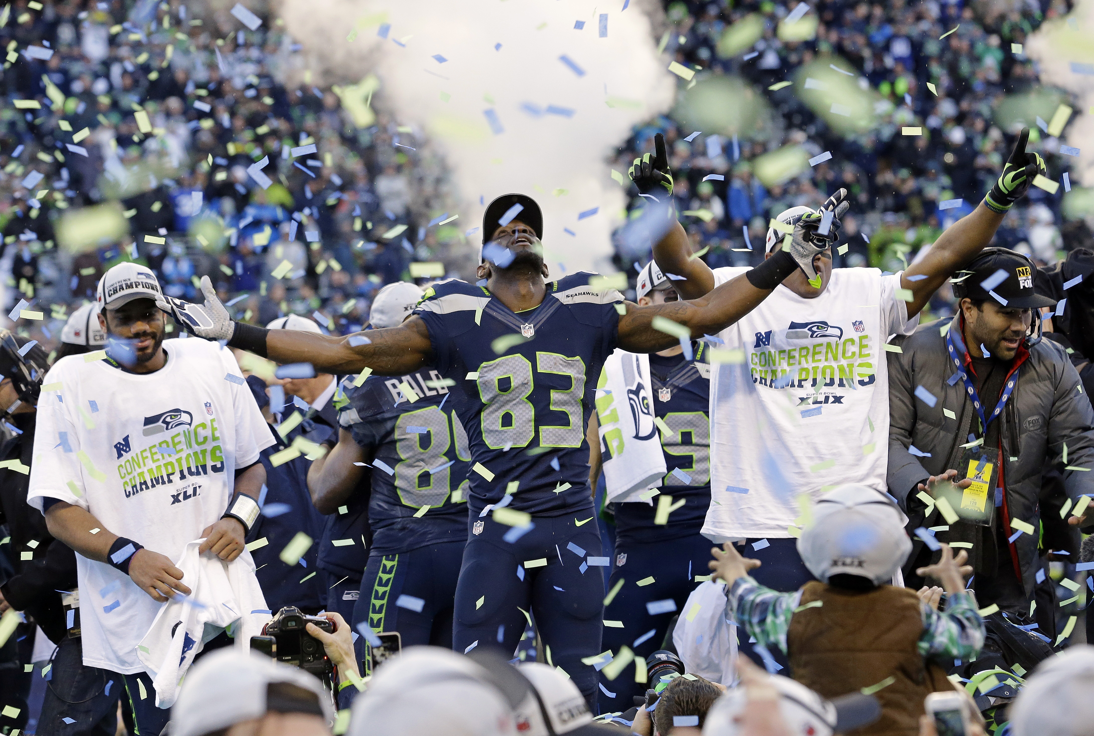
Notes:
Or do you want to be the team that keeps improving, becoming better than anyone else?

Slide 14
HOW?
Notes:
Now that we have talked about why we should do retrospectives, the next step of course is, how do we do retrospectives.
In this part we will look into the theory of how to structure a retrospective.

Slide 15

The Scrum process
Sprint retrospective
HOW?
Notes:
Looking at the Scrum process as we know it, we see that at the very end of each iteration there is a sprint retrospective meeting with the Scrum team.

Slide 16
The Retrospective
Each sprint should have a retrospective.
It is the last activity in the sprint.
A retrospective should have a facilitator.
Allocate time for it.
Use the outcomes.
HOW?
Notes:
-

Slide 17
Retrospective structure
Set the Stage
Gather Data
Generate Insights
Decide What To Do
Close
HOW?
Notes:
A retrospective is structured in 5 phases.
Now before we dive into the details of each phase, let’s have a look at why there are different phases in a retrospective.

Slide 18
OPENING
EXPLORING
CLOSING
A
B
Initial state
Target state
Set the stage
Gather Data
Generate Insights
Decide what to do
Close
HOW?
Notes:
What is it that you do in each of these stages?
Opening: set stage, develop themes, gather ideas & information
Exploring: examine, explore and experiment
Closing: you work towards conclusions, decisions & actions
Now look at how closely this format resembles the format used by Derby & Larsen

Slide 19

Set the stage

Slide 20
Setting the stage
Goal:
Set the context for the retrospective.
Create a comfortable and safe atmosphere.
Get everybody engaged.
HOW?

Slide 21
Setting the stage
As a facilitator:
Welcome everyone to the retrospective.
Explain the goal, timebox and agenda.
Use a short check-in exercise to get people engaged.
HOW?

Slide 22
Setting the stage | Example
Check-In:
Ask one question that each person can answer with one word or short phrase.
Each participant answers or explicitly passes.
Don’t go into discussion
Examples:
Your feeling about the sprint in one word?
Your hopes for the retrospective?
What do you need from this session?
HOW?

Slide 23
Setting the stage
Important:
Keep it short, but don’t skip it.
If you don’t engage them here you wont engage them later on (getting everyone to speak helps participation later on).
HOW?

Slide 24

Gather Data

Slide 25
Gather data
Goal:
Create a shared picture of what happened.
Expand everyone’s perspective.
HOW?

Slide 26


Gather data
As a facilitator:
Don’t just focus on hard facts, feelings are an equally important part of the story.
Throughout data gathering help the team identify patterns, shifts and surprises. They usually point to something of interest.
HOW?
Notes:
Sometimes you work with people that have a hard time expressing their feelings so you try to phrase your question in a different way.
For example: What were the high points, what were the low points. When were you excited to come to work, when was coming to work just a job.
When did you dread coming to work?

Slide 27

Gather data
Exercise:
Form groups of maximum 5 people.
Use the link in your e-mail.
Select a gather data activity.
Be ready to “pitch” your idea to the group:
Why this activity?
Which “issue” would you use it for?
10 Min
HOW?
Notes:
Speaker notes for the exercise:
Show the retromat website to the group.
Put the responsibility for time management with the groups.

Slide 28
Pitch

Slide 29
Gather data
Important:
When you skip this step you do not create a common picture and people tend to just verify their own opinions and beliefs.
HOW?

Slide 30

Generate Insights

Slide 31
Generate insights
Goal:
Identify strengths and issues from the previous iteration considering the data gathered.
HOW?

Slide 32
Generate insights
As a facilitator:
Lead the team to examine the conditions, interactions and patterns that contributed to their success.
Investigate breakdowns and deficiencies. Look for risks and unexpected events or outcomes.
HOW?

Slide 33
Generate insights | Example
Perfection Game:
What would make the next sprint a perfect 10 out of 10?
Prepare a flip chart with 2 columns, a slim one for 'Rating' and a wide one for 'Actions’.
Everyone rates the last sprint on a scale from 1 to 10.
Then they have to suggest what action(s) would make the next sprint a perfect 10.
HOW?

Slide 34
Generate insights
Important:
When you skip this step, the team may not understand how events, behaviors or circumstances affect their ability to develop software. It prevents jumping to conclusions.
Time spent generating insights helps ensure that when your team plans an improvement, its one that will make a positive difference.
HOW?

Slide 35

Decide what to do

Slide 36
Decide what to do
Goal:
For the team to find improvements that they can commit to and that will have a positive effect.
HOW?

Slide 37
Decide what to do
As a facilitator:
Provide structure and guidance for your team to plan experiments and actions.
HOW?

Slide 38
Decide what to do | Example
Pitch:
Ideas for actions compete for 2 available 'Will do'-slots.
WILL DO
slot 1
WILL DO
slot 2
HOW?
Notes:
Ask everyone to think of 2 changes they'd like to implement and write them down on separate index cards. Draw 2 slots on the board.
The first team member puts their favorite change idea into the first slot. His neighbor puts their favorite into the second slot. The third member has to pitch her favorite idea against the one already hanging that she favors less. If the team prefers her idea, it's swapped against the hanging one. This continues until everyone has presented both their cards.
Try not to start the circle with dominant team members.

Slide 39
Decide what to do
Important:
Use an appropriate indicator to choose, for example dot voting, or roman voting (thumbs)
Help the team limit the amount of improvements (1-3)
Make them actionable and easy to include in the sprint planning by creating story cards or backlog items
HOW?

Slide 40

Close the retrospective

Slide 41
Close the retrospective
Goal:
Decide how the team will retain what they’ve learned from the retrospective.
How to document the experience and plan for follow-up.
HOW?
Notes:
Al good things come to an end, even the retrospective.

Slide 42
Close the retrospective
As a facilitator:
End the retrospective decisively, don’t let people (or their energy) dribble away.
Close the retrospective with an appreciation for the hard work everyone did both during the iteration and during the retrospective.
HOW?

Slide 43
Close the retrospective
Important:
Facilitators need continuous improvement too.
Before you end, take a few minutes to perform a retrospective on the retrospective.
HOW?

Slide 44
Close the retrospective | Example
Helped, Hindered, Hypothesis:
Gather feedback on the retrospective.
Create 3 flip charts:
Helped
Hindered
Hypothesis
Ask participants to put stickies on each flip chart.
HOW?

Slide 45
Why this format?
Structuring your retrospectives this way will help your team to:
Understand different points of view.
Follow a natural order of thinking.
Allow the conversation to go where it needs to go, rather than predetermining the outcome.
Leave the retrospective with concrete action and experiments for the next iteration.
WHY?
Notes:
Structuring your retrospectives this way will help your team to

Slide 46
WHAT?

Slide 47

Tips & Tricks
WHAT?

Slide 48


Preparation
A retrospective takes preparation time
How much?
WHAT?

Slide 49

Preparation
Prepare to throw your plan away.
WHAT?

Slide 50
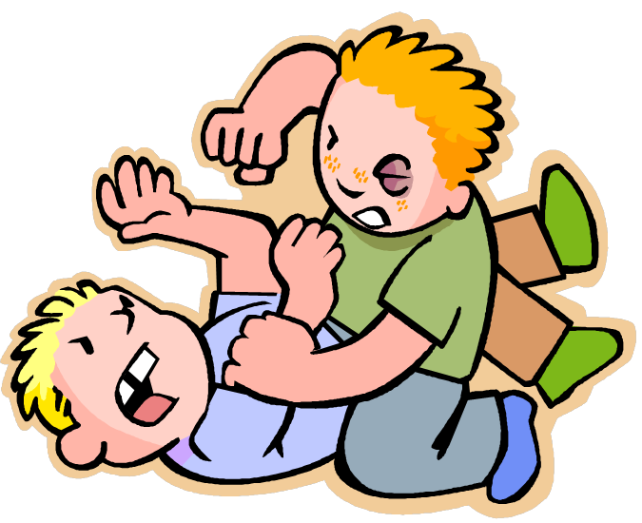
Preparation
But keep facilitating.
WHAT?

Slide 51

Preparation
Ask for help:
A colleague.
A Scrum master from another team.
An agile coach.
The agile community.
WHAT?

Slide 52
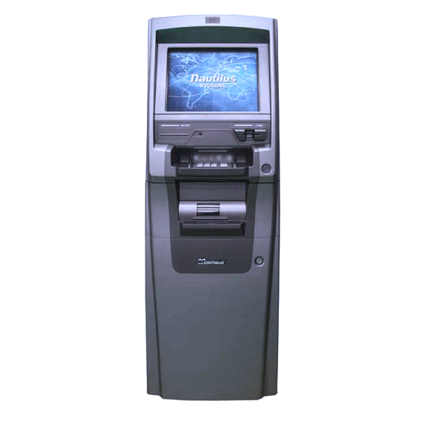
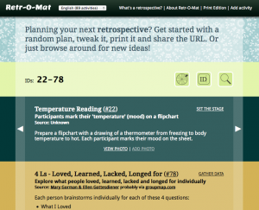
Preparation
The Retro-Mat: http://www.plans-for-retrospectives.com
WHAT?

Slide 53
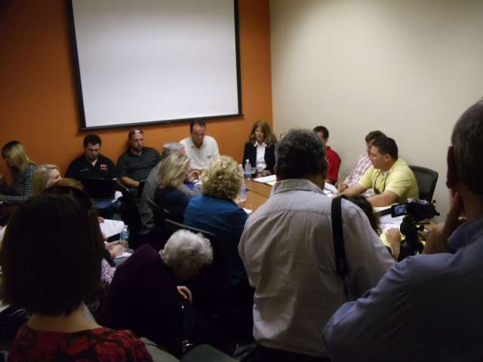
Location & Environment
WHAT?

Slide 54
Location & Environment
Pay attention to the location and environment:
Get rid of meeting room tables.
People should be able to move freely.
Light and oxygen.
Facilitation supplies galore.
WHAT?

Slide 55



Location & Environment
Snacks
Music
WHAT?

Slide 56
Location & Environment
But we don’t have suitable locations.
Be creative:
Atrium.
Canteen.
Local restaurants and bars.
Roof terrace.
WHAT?

Slide 57
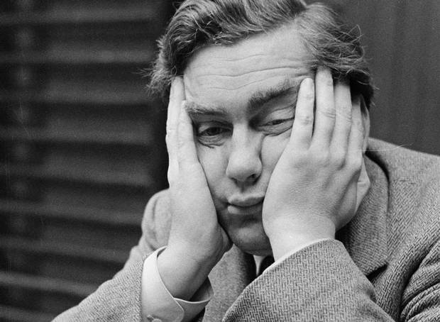
Variation
WHAT?
Notes:
Using the same format over and over again endlessly will get people bored.
Boredom in retrospectives is one of the worst things you can have. Bored people are not fully engaged in the retrospective and won’t contribute.

Slide 58
Variation
1000+
retrospective formats available
WHAT?

Slide 59
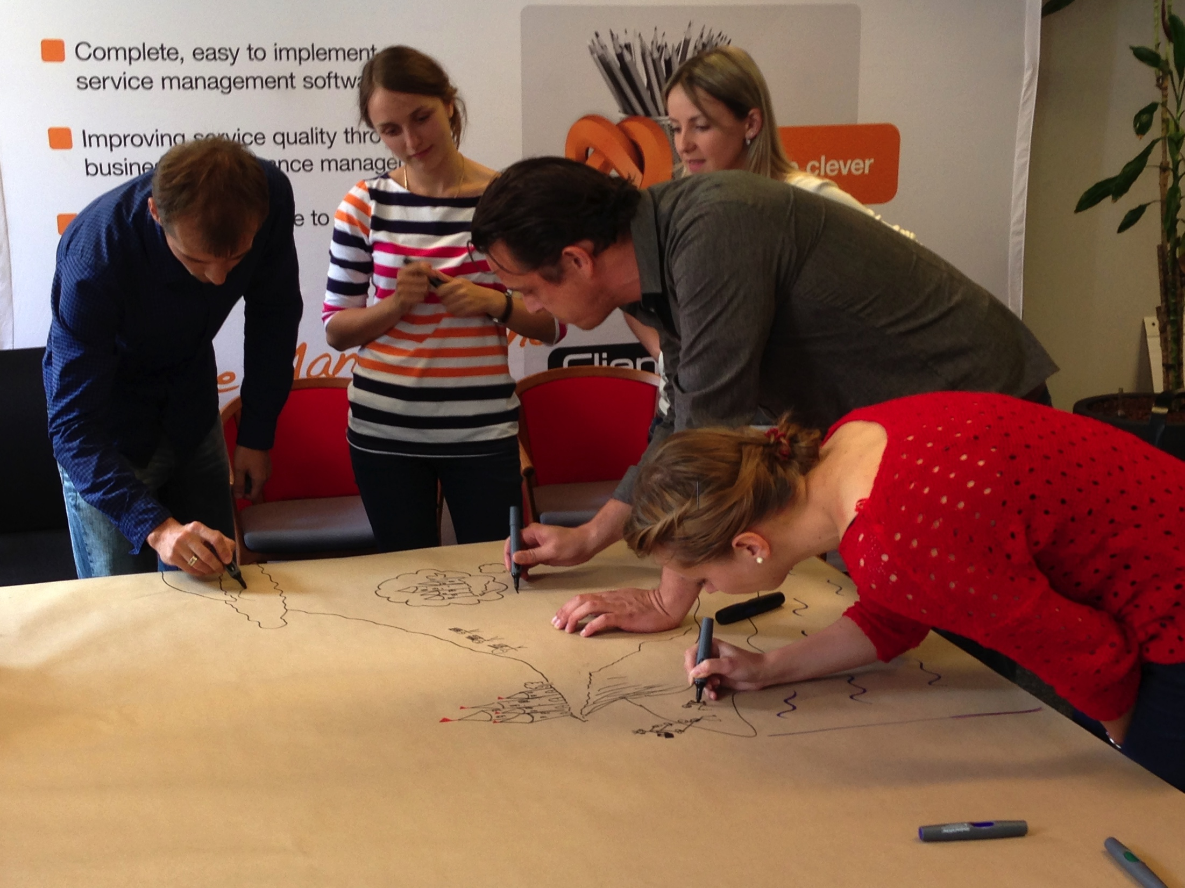
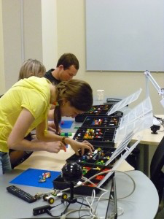

Variation
Trigger creativity.
WHAT?
Notes:
Triggering creativity will bring up discussions that would otherwise not surface.

Slide 60
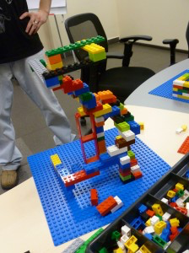
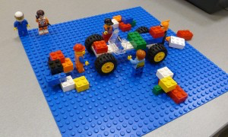
Variation
WHAT?

Slide 61
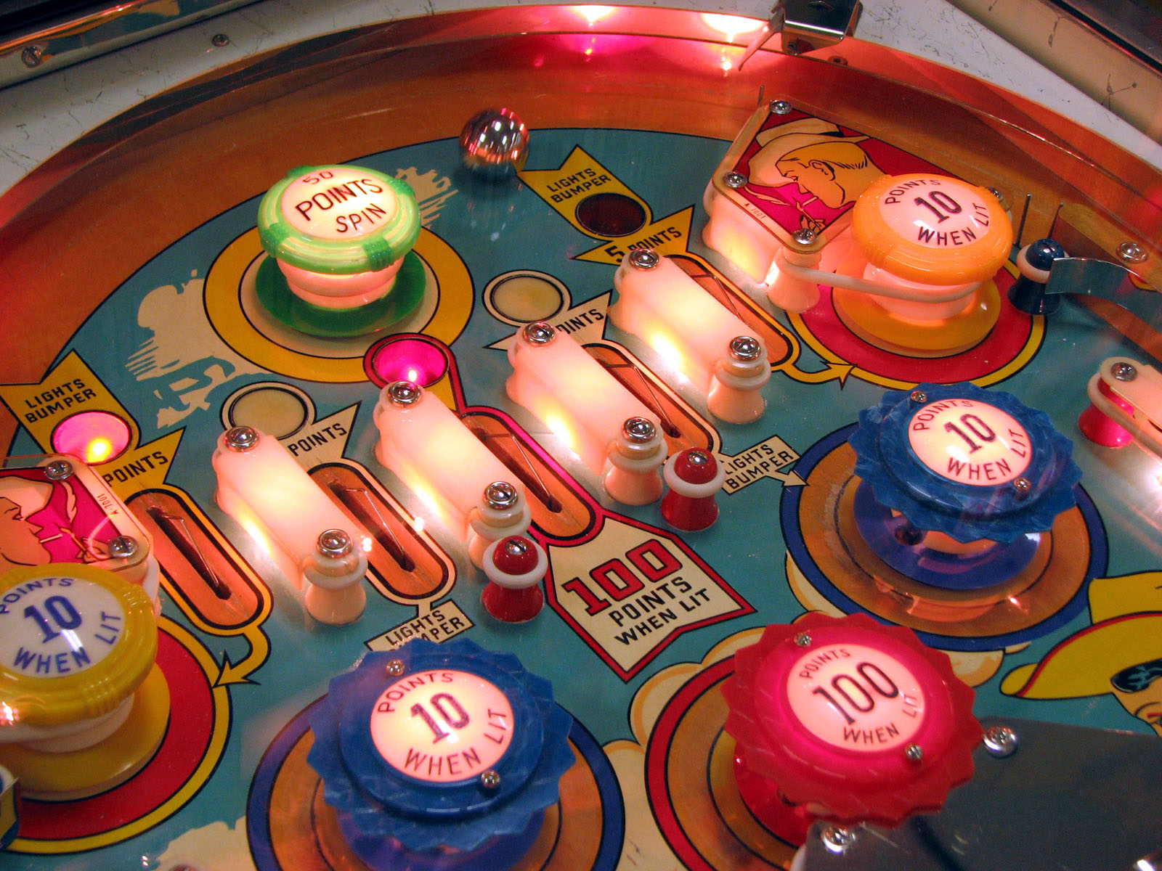
Variation
WHAT?
Notes:
You also don’t want to give people the feeling that they are in a pinball machine, bouncing in a different direction every time.
When bringing variation in your retrospectives, make sure to find a balance that accommodates the team.

Slide 62
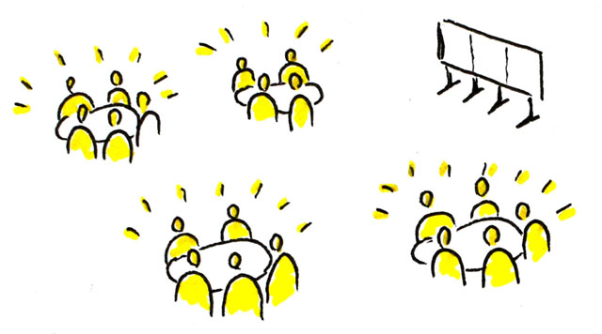
Facilitation
Split up in small groups.
WHAT?

Slide 63
Facilitation
Smaller group benefits:
Every voice is heard.
Increases engagement of participants.
Gathering multiple insights.
Cancels out dominance in opinion and communication.
WHAT?

Slide 64
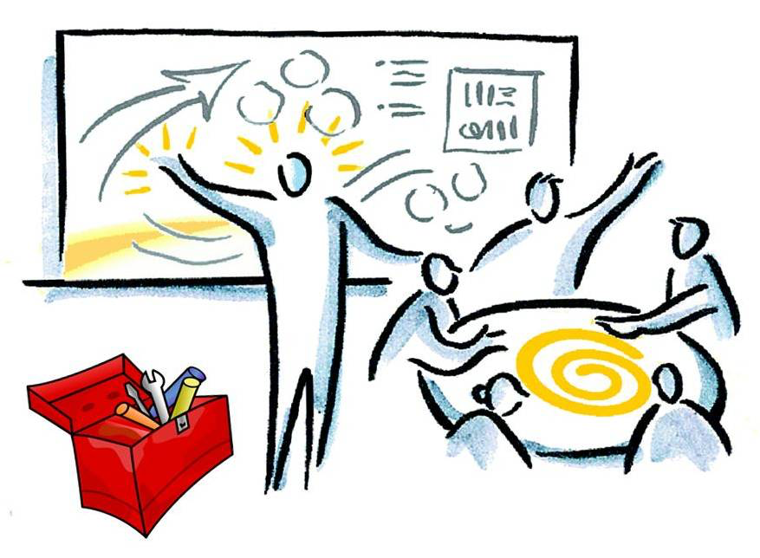
Facilitation
To facilitate or to participate, that’s the question.
WHAT?

Slide 65
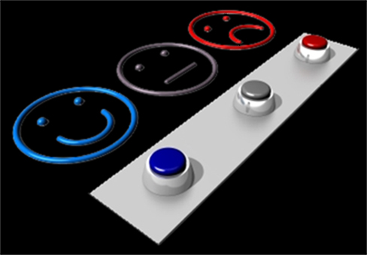
Facilitation
Evaluate yourself as a facilitator
WHAT?

Slide 66


Remote retrospectives
WHAT?
Notes:
At some point there will be the need to have interaction within a retrospective with people that are not all on the same location.
This could be people working in different offices, but also could well be people that are not able to come to the office (traffic, public transportation problems, snow storms, etc).

Slide 67
Remote retrospectives
Tips for remote retrospectives:
Always use video conference.
Working in small groups becomes more important.
Stickies don’t work remotely:
Online whiteboard / screen sharing.
Online retrospective work formats.
Don’t start remotely.
WHAT?
Notes:
Creating and facilitating valuable remote retrospectives is a topic on it’s own and is beyond the scope of this training, but since it is already happening to some extend for several teams in these specific circumstances a few pointers that should be taken into account.

Slide 68


Slide 69

Learning about retrospectives
A must read:
Agile retrospectives, making good teams great
Esther Derby & Diana Larsen
WHAT?
Notes:
A must read for everyone that is learning about retrospectives is the book from Esther Derby & Diana Larsen. This book will explain the basic structure of retrospectives as it is also used in this presentation and gives a large number of sample excercises for each phase of the retrospective.

Slide 70
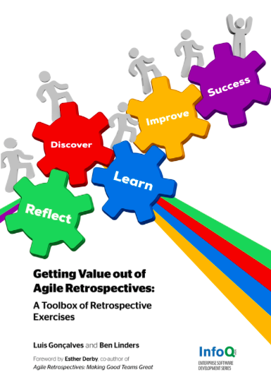
Learning about retrospectives
Retrospective exercises
Availabe for free online on LeanPub https://leanpub.com/gettingvalueoutofagileretrospectives
WHAT?
Notes:
Recently Ben Linders (Dutch) and Luis Goncalves (Portuguese) have written a book together with a number of retrospective exercises that you can use in your own retrospectives.

Slide 71
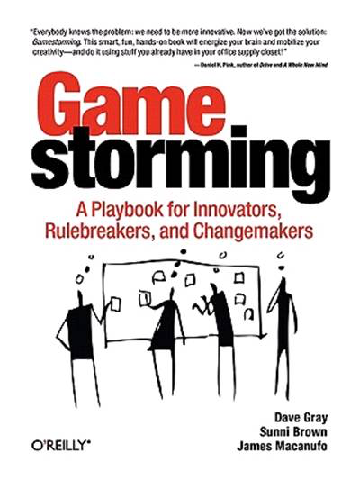

Learning about retrospectives
Useful work formats for retrospectives
WHAT?
Notes:
Not directly related to retrospectives, but two books full of creative excercises to engage meeting participants in the thought process.

Slide 72
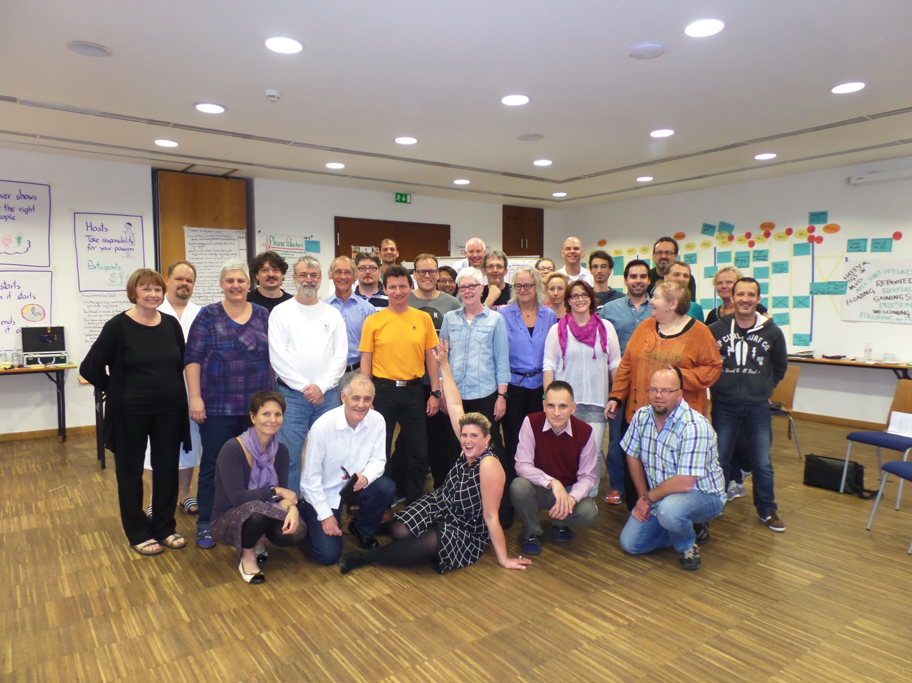
Learning about retrospectives
Retrospective
Facilitators
Gathering
WHAT?
Notes:
The main event focused solely on retrospectives is the Retrospective Facilitators Gathering. A 5 day open space conference with the most experienced retrospective facilitators across the globe such as Esther Derby and Diana Larsen themselves.
Organized in Europe in the even years and the US in the Odd years (2015 Lake Tahoe, 2016 Lisbon).
One catch, you need to be introduced by a previous participant to be invited to it.

Slide 73
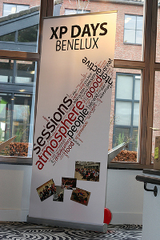
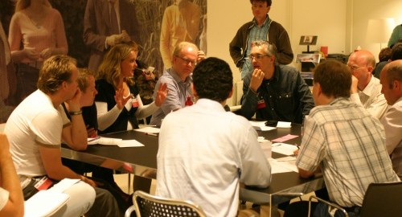
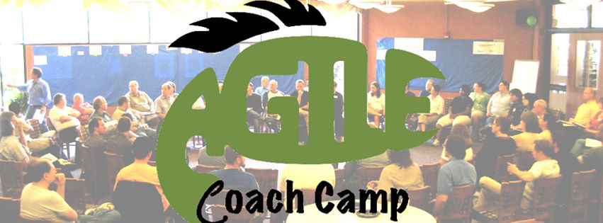
Learning about retrospectives
Agile Open Holland
WHAT?
Notes:
Besides the specific retrospective facilitators gathering there are multiple open events where you can connect with people from the agile community:
Agile Coach Camp; Open space conferences organized in: Netherlands, Italy, Germany, Spain, Denmark, etc.
Agile Open Holland; Yearly open space conference.
XP Days Benelux; Yearly agile conference organized in Belgium or Netherlands.

Slide 74
One more thing….

Slide 75
Remember this?
Evaluate yourself as a facilitator

Slide 76
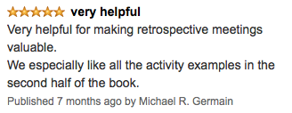
Close the retrospective
Amazon review:
Write a short Amazon style review on the retrospective with:
Star rating 1 to 5
Title
Content
Let everyone read out their review.
Record the star rating on a flip chart.
Notes:
Write a short Amazon style review on this retrospective training to help the trainer improve the training.

Slide 77

?
Notes:
Questions?

Slide 78




More information
http://www.slideshare.net/muldersj/presentations
https://github.com/Kuzidi/agileretrospectives
https://twitter.com/joostmulders

